Slide 1


Slide 2
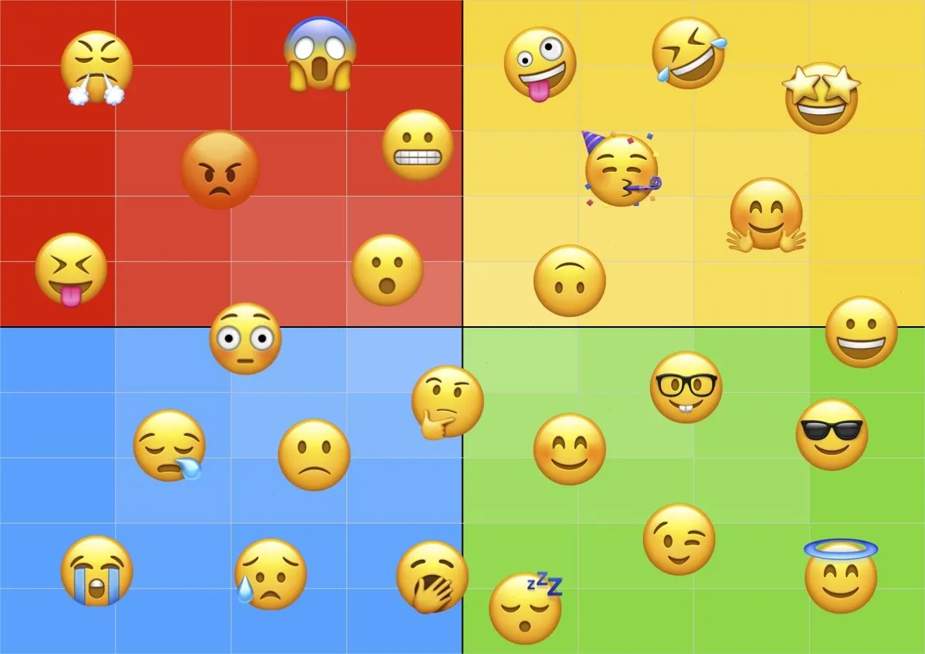
Starter task: Which emoji best describes your holiday and why?

Slide 3
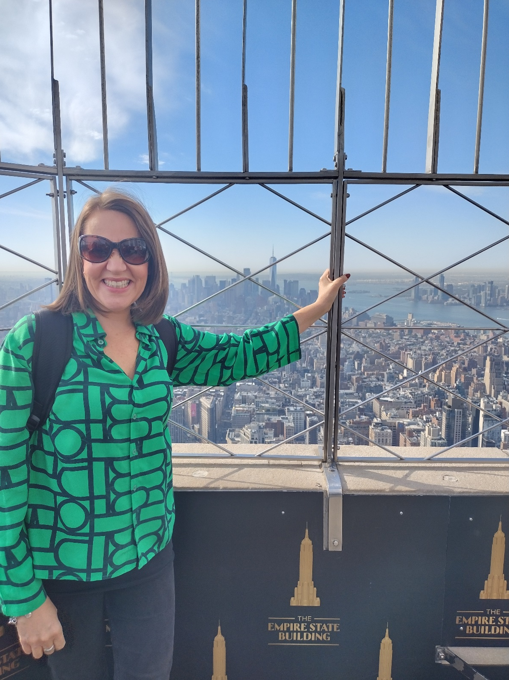
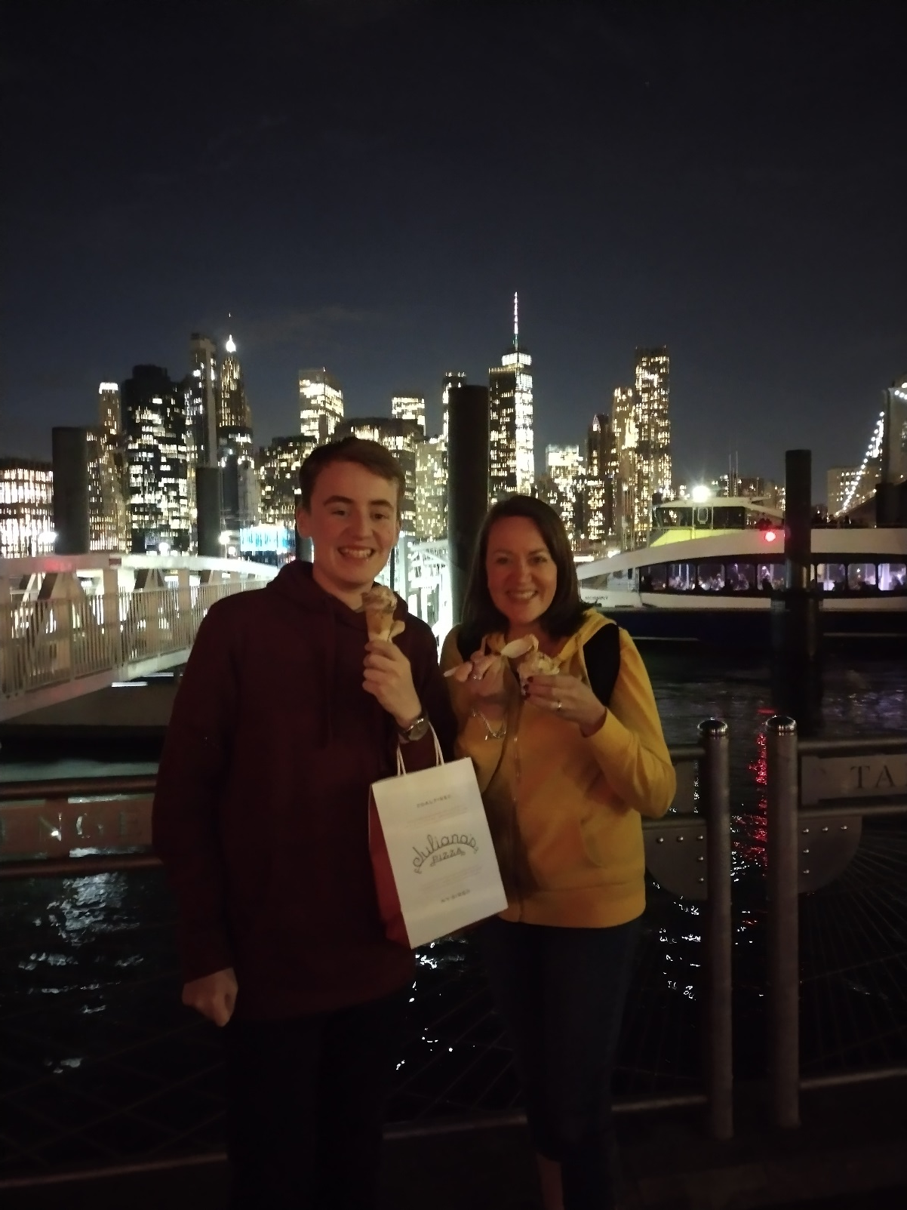

Slide 4
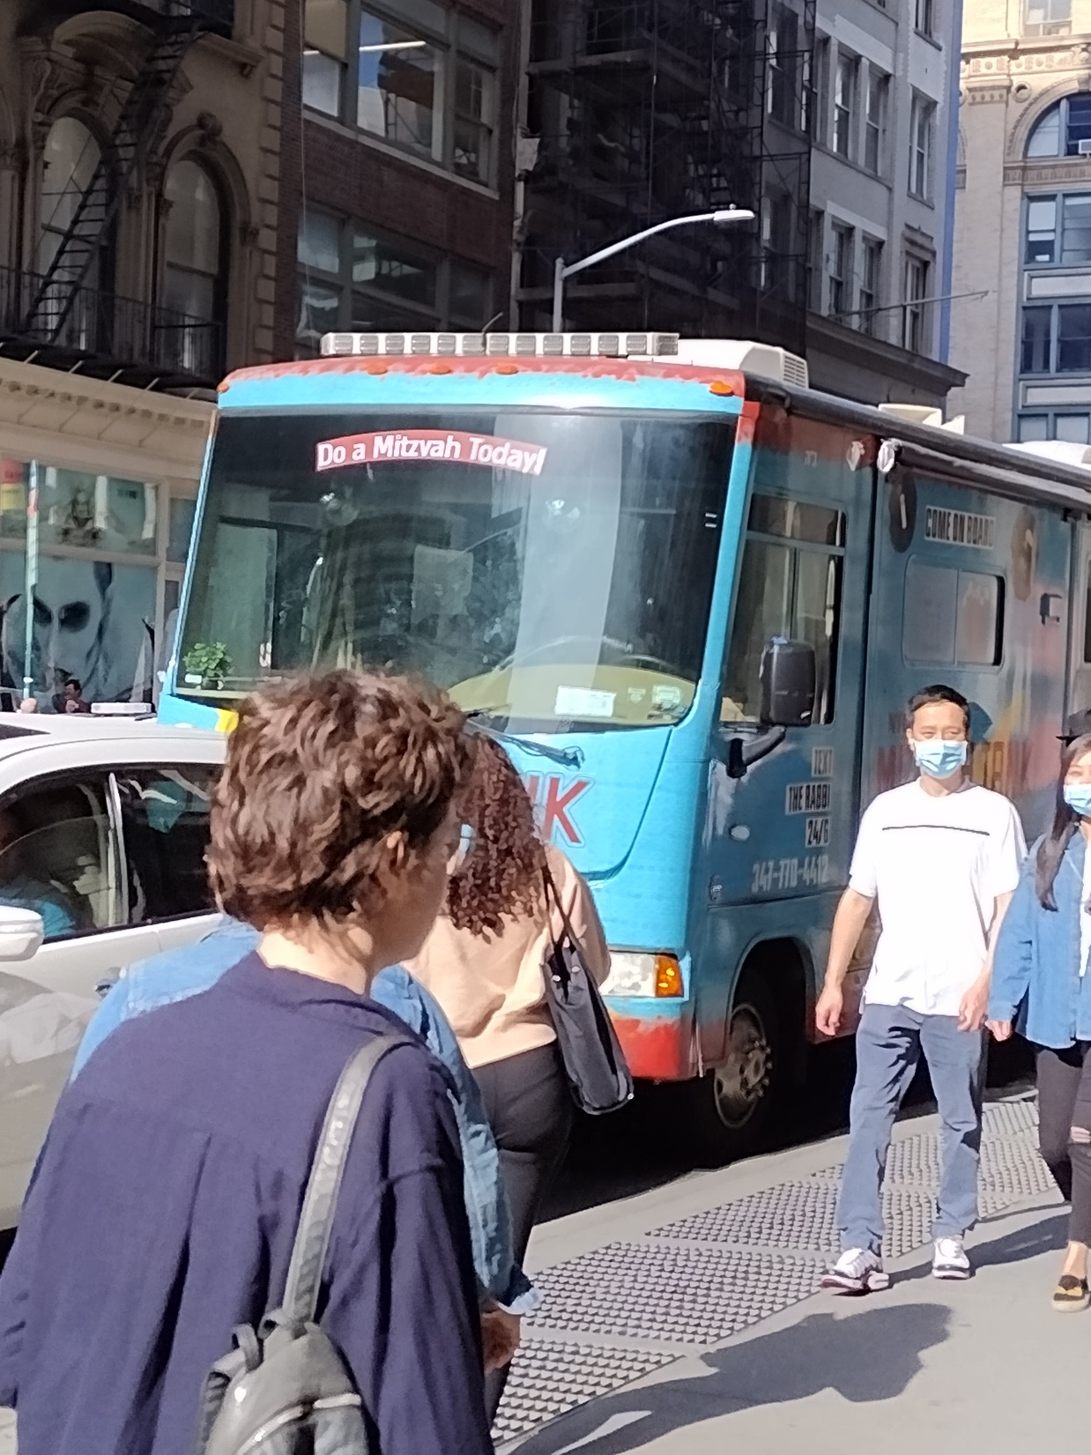

Slide 5
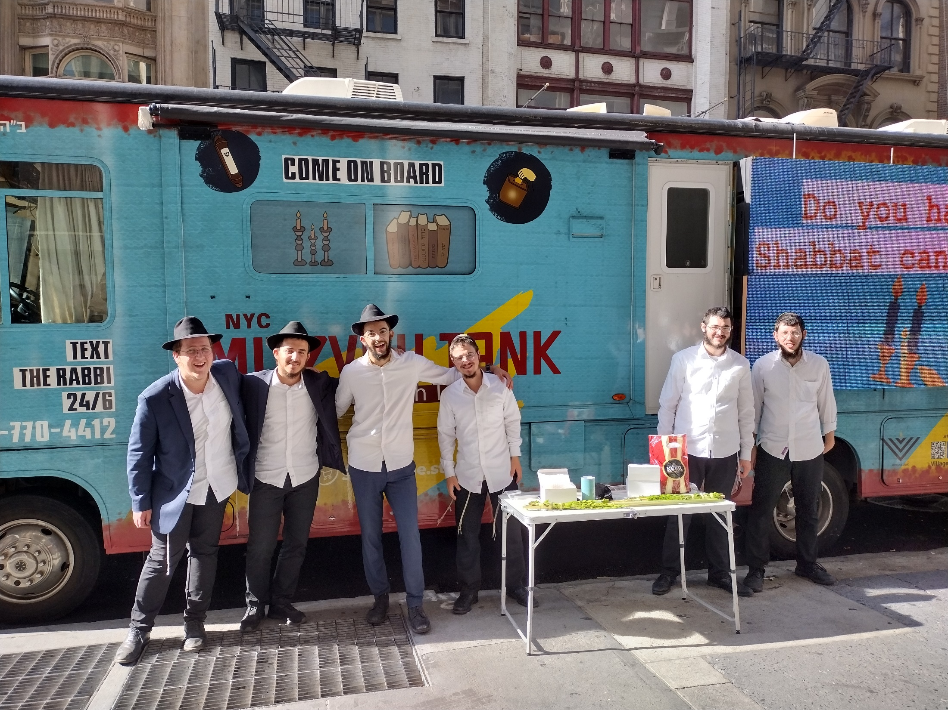

Slide 6
Judaism
Beliefs
• beliefs about God
• nature of human beings: yetzer tov; yetzer harah; free will; suffering
• beliefs about Covenant
• judgement; the Messiah; the Messianic Age; Olam Ha’ba
Practices
• living according to the Commandments
• Rosh Hashanah; Yom Kippur
• worship: Shabbat; synagogue

Slide 7
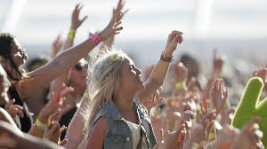
What is worship?
What does it mean?
What does it look like?
24.10.22 Worship
​
Dictionary definition
Worship:
1. To have or show a strong feeling of respect and admiration for God or a god.
2. To go to a religious ceremony.
3. To give something worth.

Slide 8
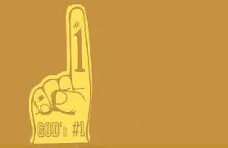
For Jewish people worship is about giving God thanks and praise.
It is considered to be a response to God's love for his people.
According to the Torah, God has made a covenant with his people so they try to respond by being holy and keeping his laws, part of that is worship.
Remember the first commandment?
Worship happens in several ways but one of the most significant is by prayer.

Slide 9
Prayer
It’s all about communication.
The Hebrew word for prayer means 'to judge oneself' and underlines the purpose of prayer. When praying Jews look deep within themselves at their role in the universe and their relationship with God.
Jews, like other people of faith, pray for many different reasons:
They pray to ask God for help and advice.
They pray to show their belief.
They pray to talk to God about whatever is on their heart.
They pray to show they are part of a worshipping community
They pray because the mitzvot tell them too.
Choose two of these reasons and add them to your notes.

Slide 10
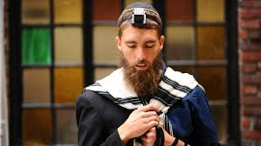
Praying regularly enables a person to get better at building their relationship with God. After all, most things get better with practice.
There are prayers of thanksgiving, prayers of praise, and prayers that ask for things.
Jews believe that God will take action in response to prayer, and a teaching from the rabbis tells us that:
“The more we ask God to help us, the more God will love us.” (Midrash Tehillim 4:3)

Slide 11
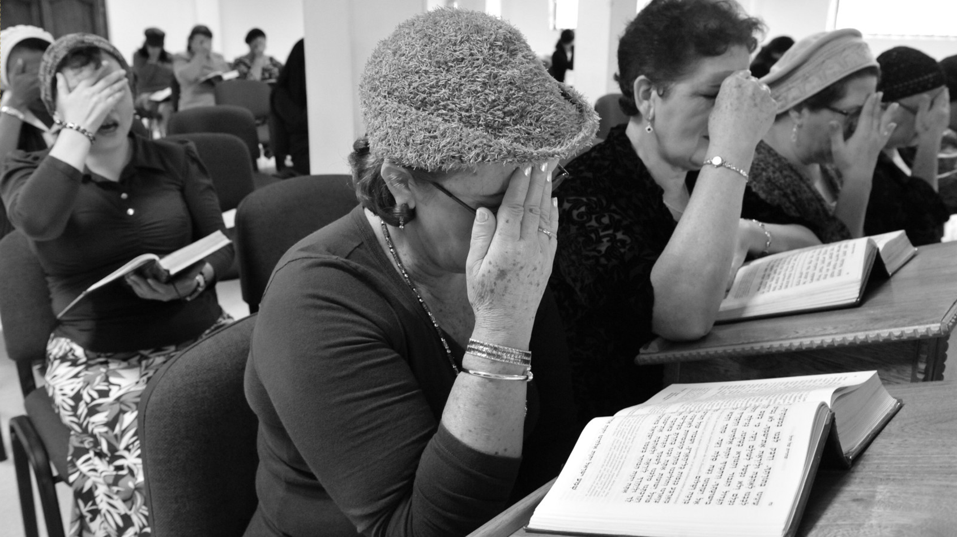
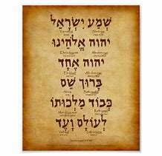
The Shema:
The Shema is the most important prayer in Jewish tradition – it is the mission statement of their faith.
The prayer is said at both morning and evening services and before going to sleep.
It is also the first prayer that Jewish children will be taught.

Slide 12
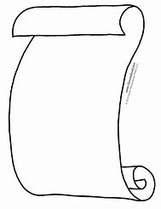
“You shall love the Lord your God with all your heart and with all your soul and with all your might. Take to heart these instructions with which I charge you this day. Impress them upon your children. Recite them when you stay at home and when you are away, when you lie down and when you get up. Bind them as a sign on your hand and let them serve as a symbol on your forehead, inscribe them on the doorposts of your house and on your gates.”
Deuteronomy 11:13-21
Lets read it carefully and understand what it actually means.
Stick a copy of the Shema into your jotter. Underneath it summarise what it means.

Slide 13
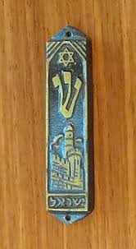
A mezuzah that contains the Shema written on a scroll is often attached to the front door of a Jewish persons home .
Jews touch this as they enter their homes.
Why do you think they do this?

Slide 14
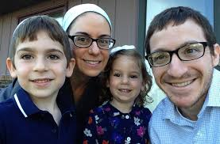
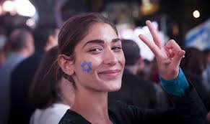
Another aspect of worship is attending shabbat and going to the synagogue.
. They attend services there once a week, where they learn more about God but also spend time with their extended family and friends.
. They have special ceremonies like marriages and funerals there.
. It is also often used as a community centre.
So the Synagogue holds many memories and important moments for a Jew.

Slide 15
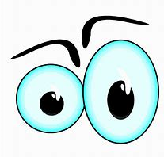
Lets look at some synagogues around the world.

Slide 16
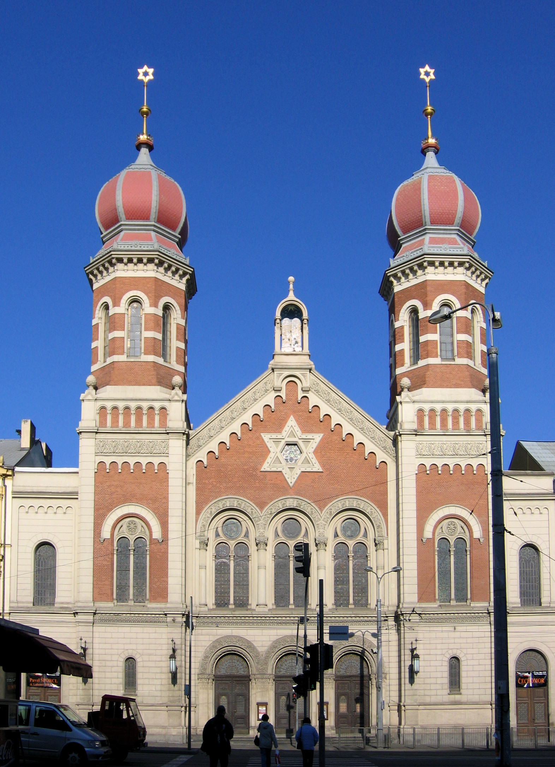
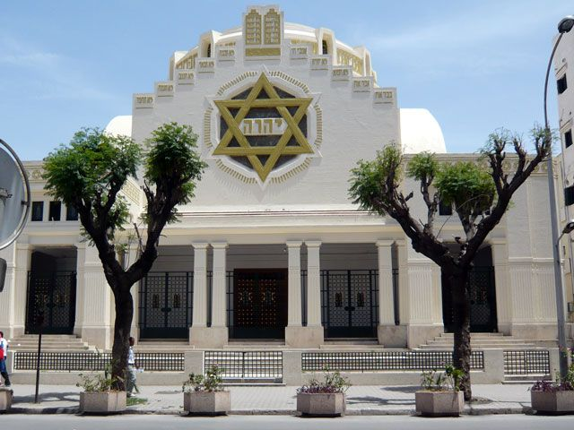

Slide 17
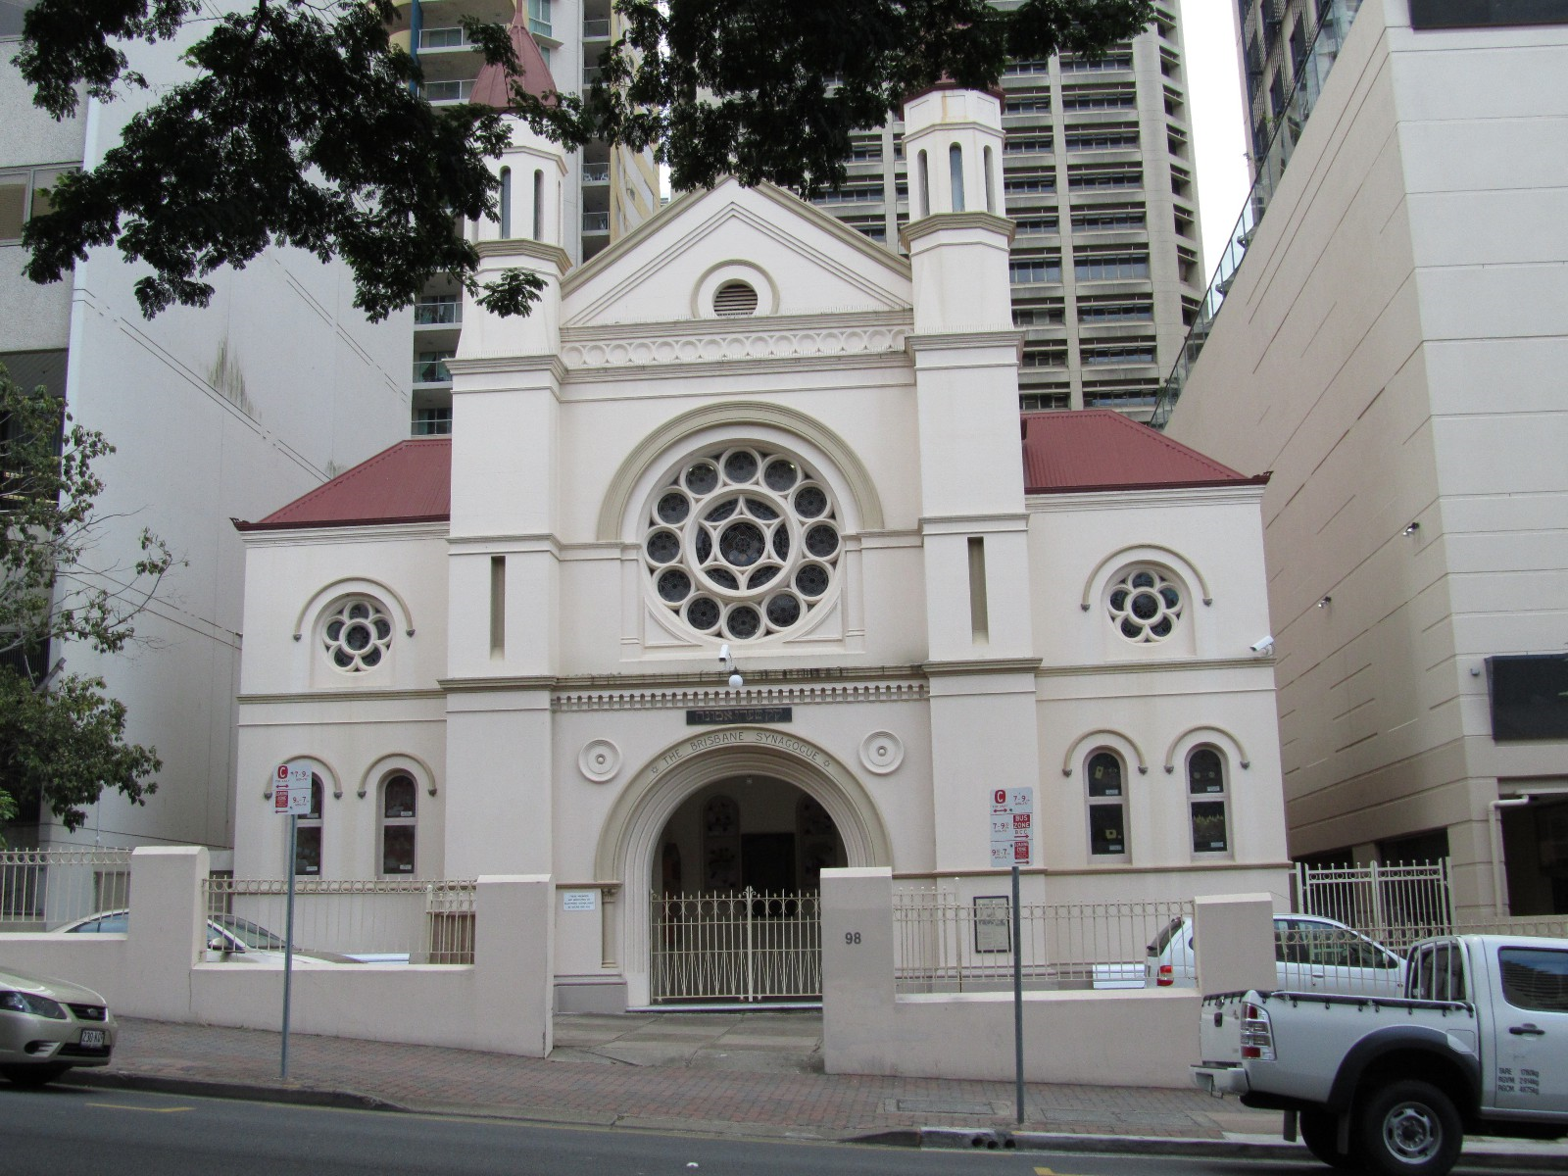
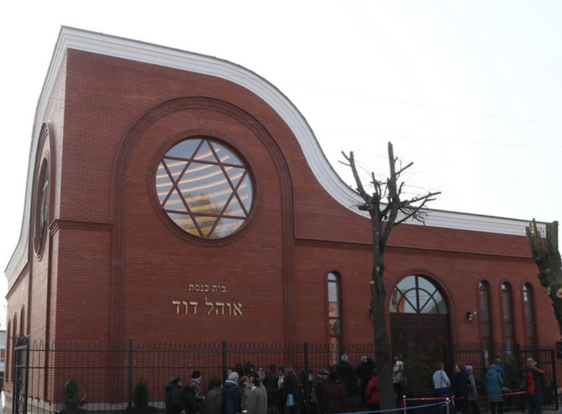

Slide 18

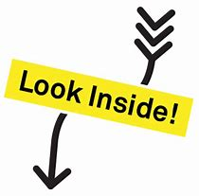
Lets look inside the building….
What do you notice?

Slide 19
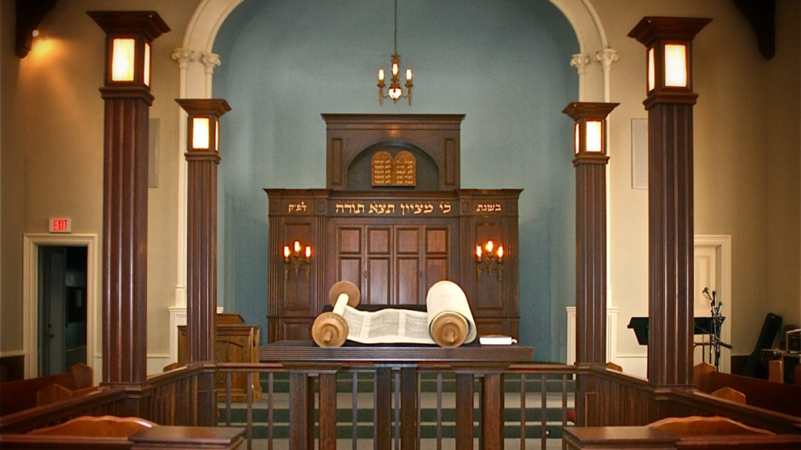

Slide 20
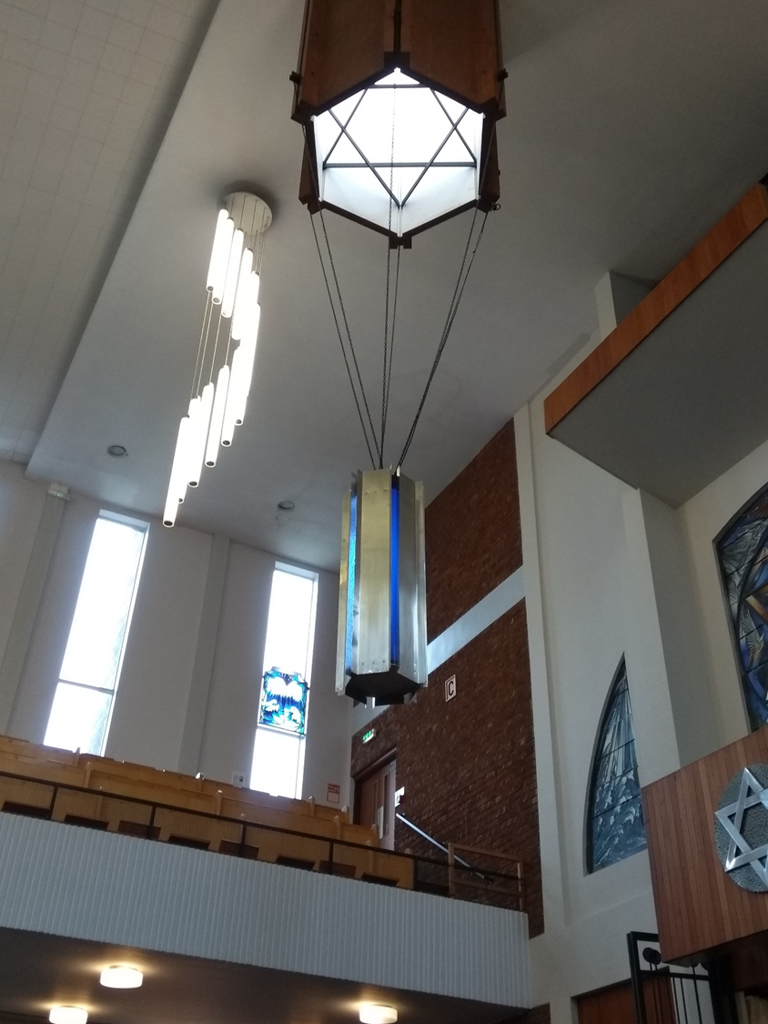
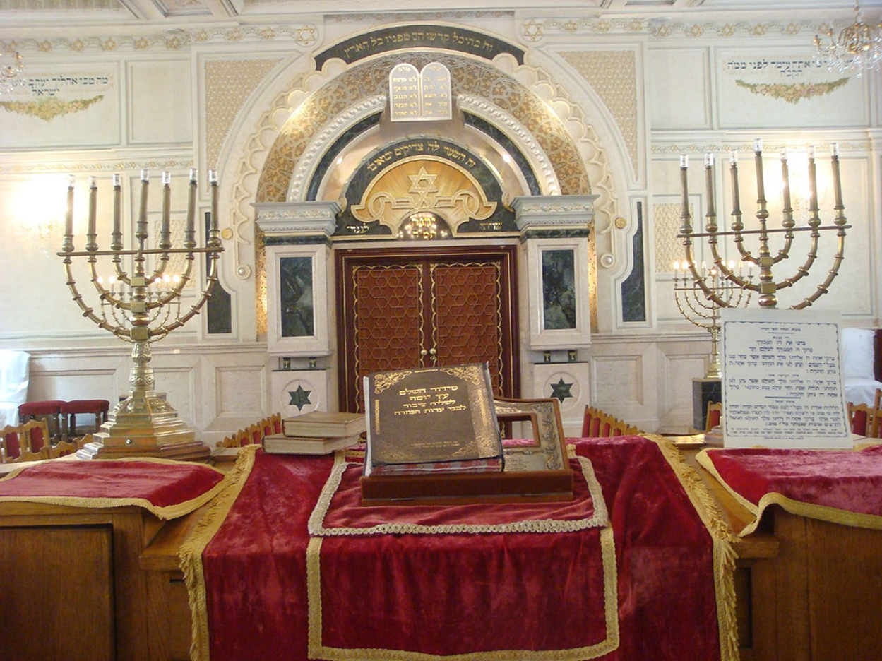

Slide 21
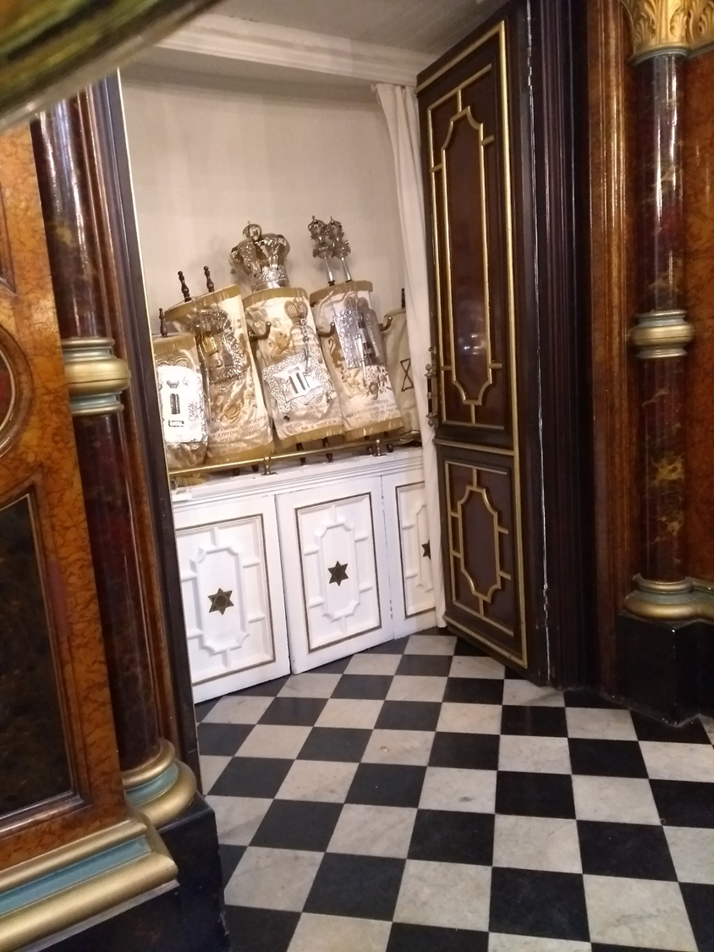
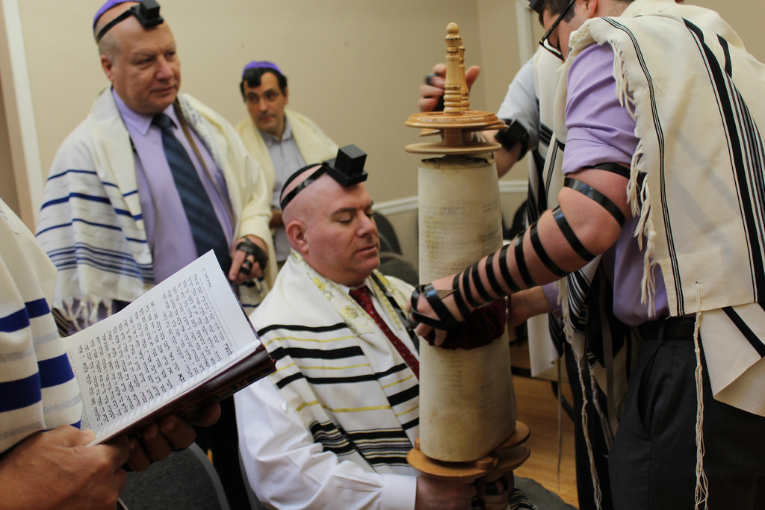

Slide 22
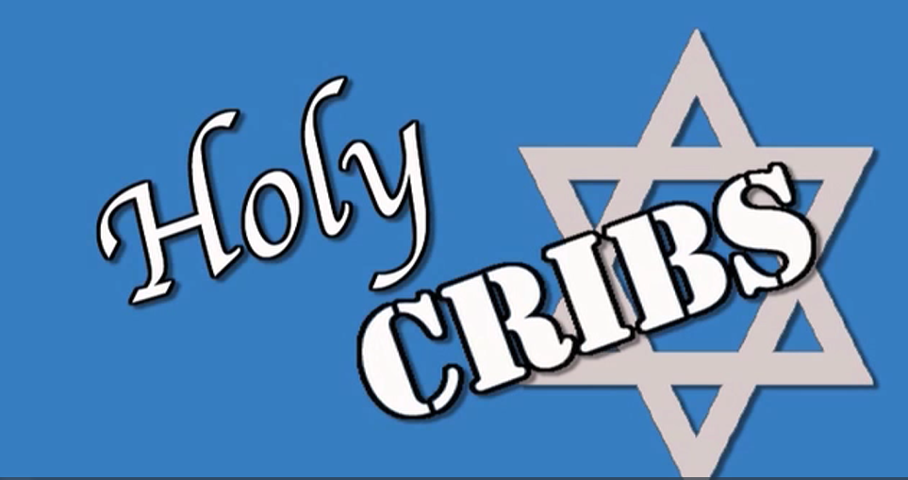
Lets learn a little bit more from A Jewish persons point of view

Slide 23
Research task
You are going to research the Synagogue and become an expert about 3 aspects.
Two aspects of the building:
The ark, the torah scrolls, the star of David the Ner Tamid or menorah
One aspect of clothing:
The kippah, the tallit, the tefillin
For each aspect write:
1. A description of what it is.
2. An explanation of its purpose/significance/impact on Jews.
Resources:
Information sheets on GC
Judaism- Living faiths p40-41 and 46-47
Judaism- Modern World Religion p14-17 and 24-25
Google!

Slide 24
Essay:
Evaluate the relevance of living according to the commandments
20 marks.
Homework
Due: 31st October
(2nd Monday after the holidays.)

Slide 25
Why Jews attend the Synagogue
. To worship God giving him thanks and praise.
. To listen to the Torah.
. To pray and ask God for help.
. To learn more about God’s laws.
. To meet with other believers.

